Slide 1
Web Design class no 4
Anik Chowdhury

Slide 2
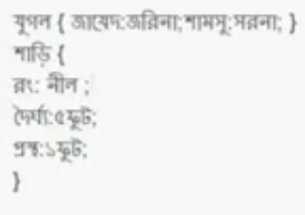
Introduction to css3

Slide 3
CSS Backgrounds
Set the background color of a page Set the background color of different elements Set an image as the background of a page Bad background image How to repeat a background image only horizontally How to position a background image A fixed background image (this image will not scroll with the rest of the page) All the background properties in one declaration Advanced background example

Slide 4
Try to learn from different codes!!!

Slide 5
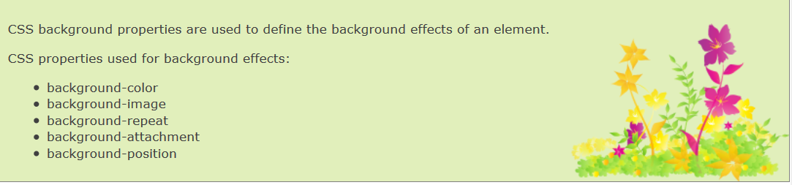
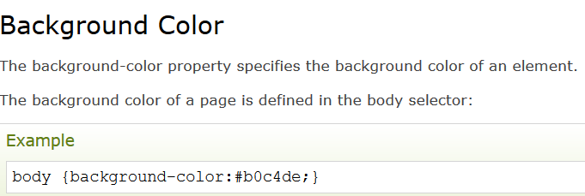
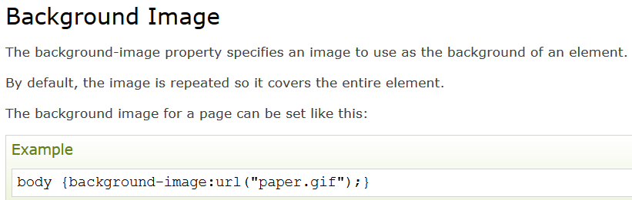

Slide 6
CSS Text
Set the text color of different elements Align the text Remove the line under links Decorate the text Control the letters in a text Indent text Specify the space between characters Specify the space between lines Set the text direction of an element Increase the white space between words Disable text wrapping inside an element Vertical alignment of an image inside text

Slide 7
Elements of table:

Slide 8
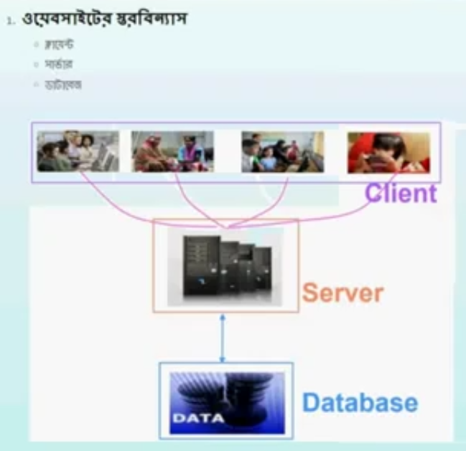
How Internet or Website works??

Slide 9
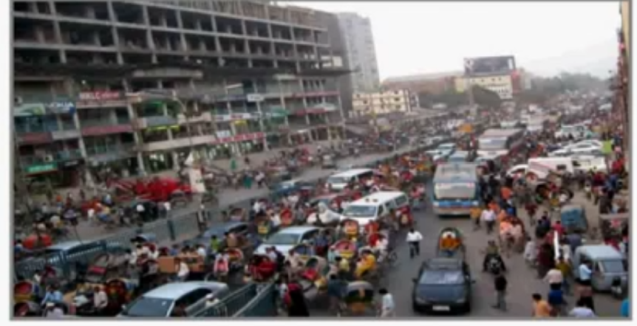
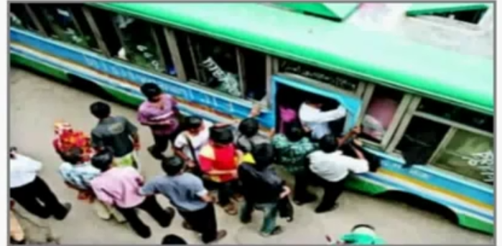

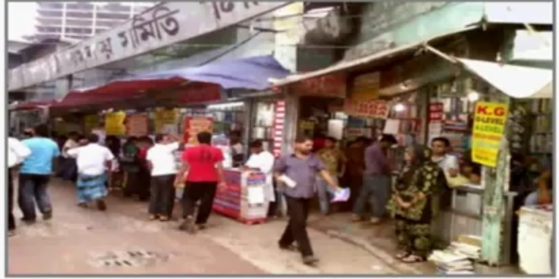
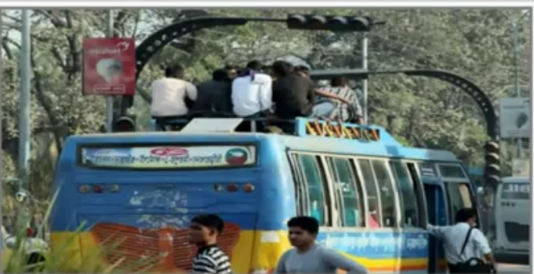

Slide 10
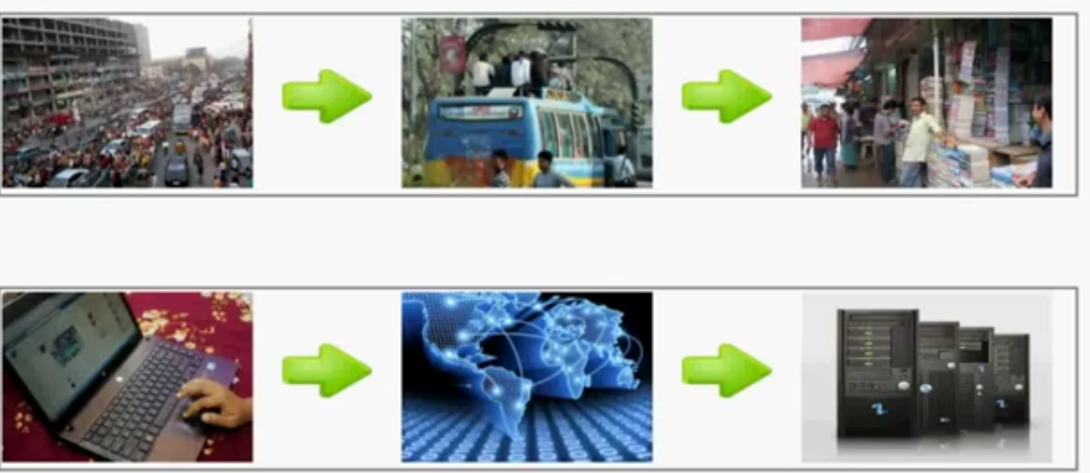
internet

Slide 11
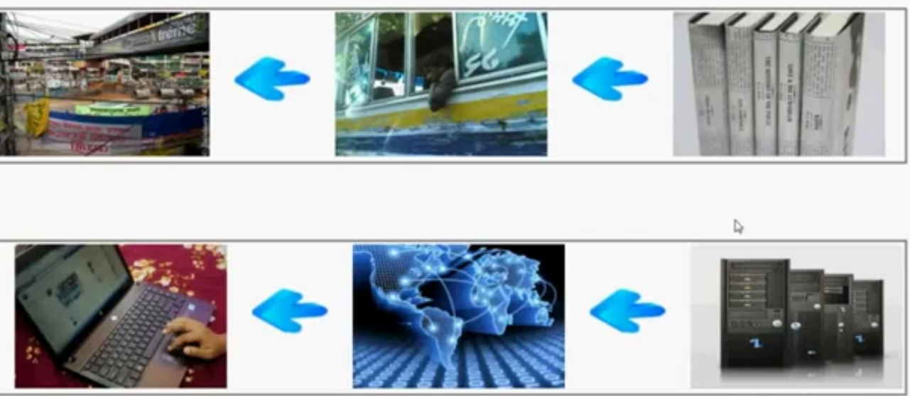

Slide 12


Slide 13






Slide 14





Xeonbd.com

Slide 15
More details on domain & hosting in last class….
#Server & Client
#IP address
#Domain Name
#URL

Slide 16
Elements of content grouping:

Slide 17
Elements of sections:

